Slide 1
A High-level Overview of Healthcare Analytics
INFO 650
Arun Sen
Portal: http://ecampus.tamu.edu
Email: via Portal
Used several resources from the Internet and also from papers. I have not cited them explicitly in the slides as they would make the slides look bad.

Slide 2
Healthcare in US

Slide 3
Levels of Care in US
Primary Care: For most illnesses, injuries and preventive health care, people usually go first to their primary care provider.
Specialized Care: Specialty care includes physical therapy, travel services, sexual health care, laboratory and x-ray, allergy shots, a full-service pharmacy, dermatology, obstetrics, orthopedics and others.
After-hours Urgent Care
Emergency Care: For life-threatening health problems (such as heart attack, serious traumatic injuries, breathing problems, high fever, serious burns, or alcohol poisoning), patients go directly to the Emergency Department
Hospitalization: Hospitals offer a variety of inpatient and outpatient services including: surgery; behavioral health (mental health) services; child birth options, comfort management for mothers and new babies; pediatric care for sick children; and a medical rehabilitation unit for people recovering from major trauma, head injury, and stroke. Outpatient services are offered and include outpatient or same-day surgery, comprehensive outpatient rehabilitation services, and diagnostic radiological testing, from routine x-rays to MRI.

Slide 4
Payment History in US Healthcare
1910’s – health care cost is much smaller than lost wages
1920’s - health care cost started to rise; sickness insurance was provide.
1929 – health care insurance started.
1930’s – Blue Cross started
1940’s – more private insurance companies started
1964/65 – Medicare and Medicaid
1983 – Medicare turns to price control
1990’s – Search for quality …

Slide 5
Payment Models in US Healthcare
Fee-for-service (FFS) is a payment model where services are unbundled and paid for separately. In health care, it gives an incentive for physicians to provide more treatments because payment is dependent on the quantity of care, rather than quality of care. FFS is the dominant physician payment method in the United States.
Pay for performance (P4P)
Medicare Shared Savings (Share the savings for good health)
Episode based payments or Bundled payments (for entire episode in-patient, out-patient etc.)
Capitation (pays to the provider whether or not the patients come or not)
Accountable Care Organization (Accountable Care Organizations (ACOs) are groups of doctors, hospitals, and other health care providers, who come together voluntarily to give coordinated high quality care to their Medicare patients.)

Slide 6
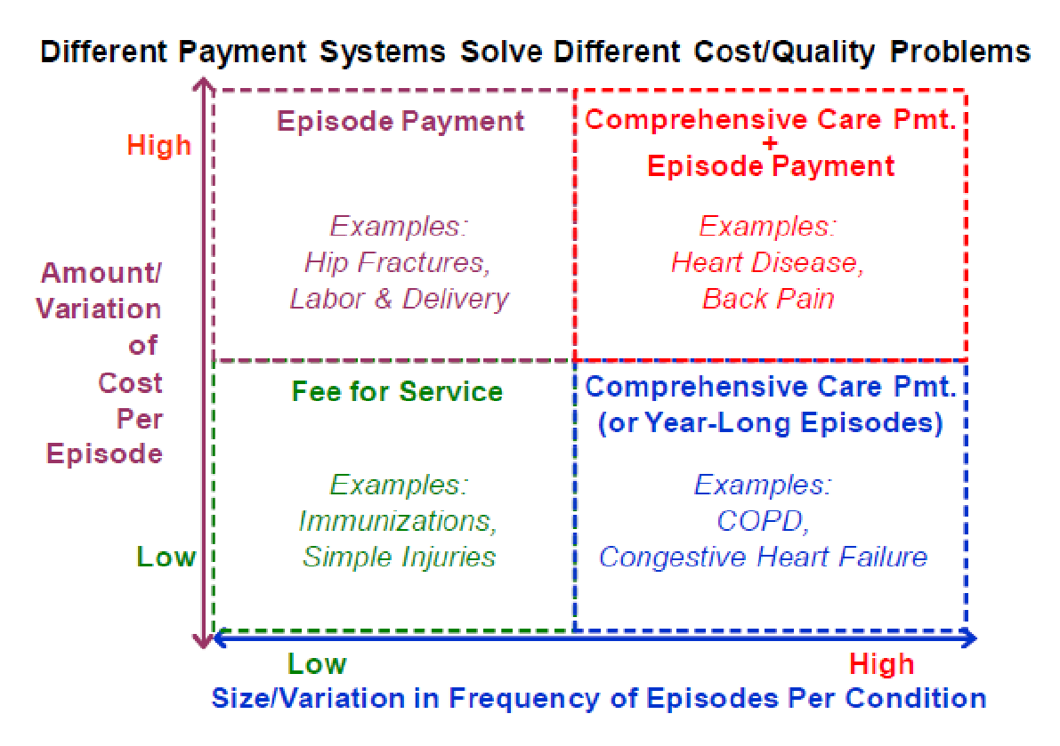
Payment Variations

Slide 7
Healthcare Modernization in US

Slide 8
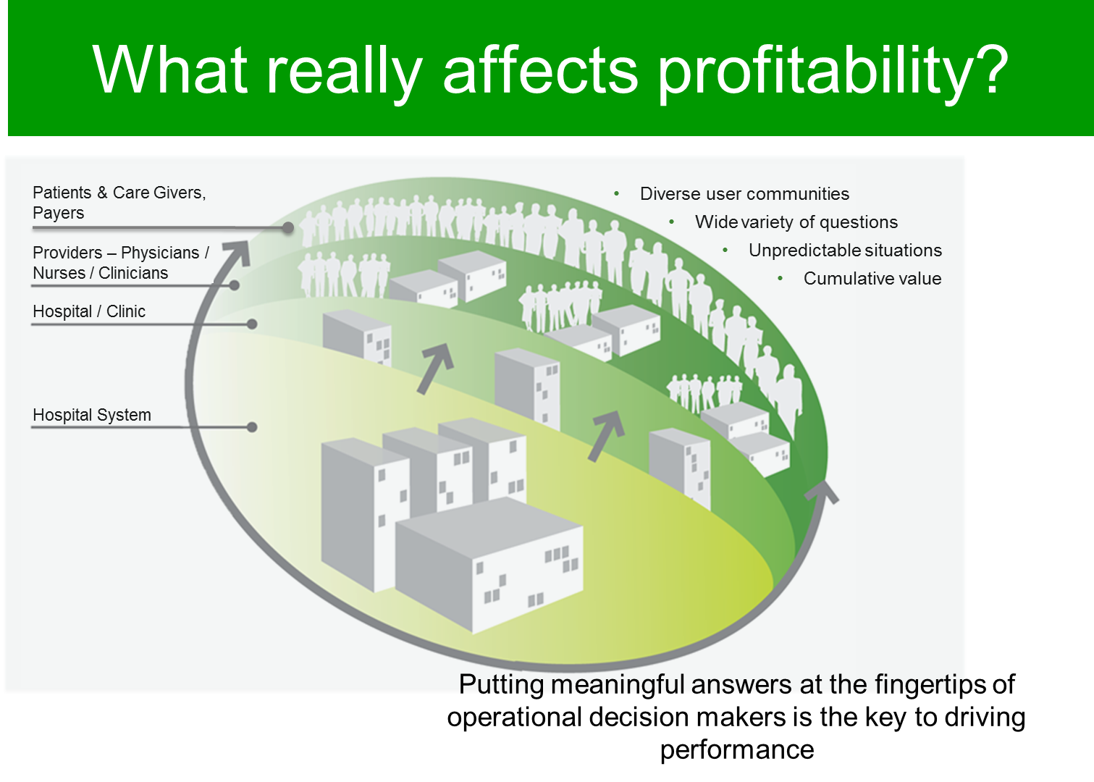
Players in Healthcare

Slide 9
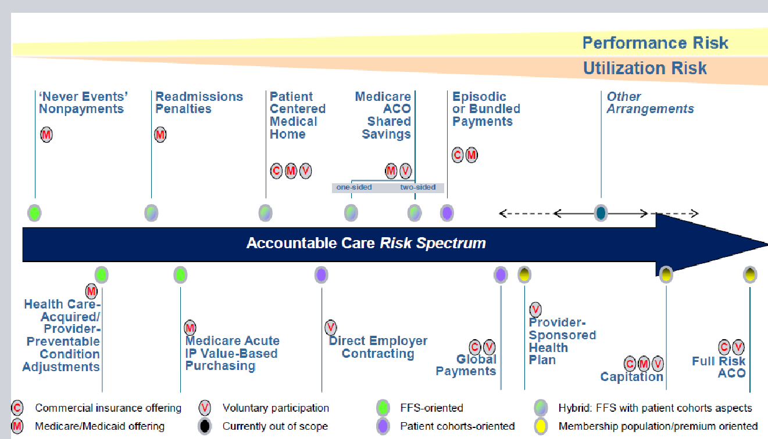
Payment Mechanisms in ACO

Slide 10
Healthcare Trends
Increasing compliance pressures
Higher patient volumes
Profitability challenges and cost reduction objectives
Performance improvement – quality, efficiency & cost
Improving the patient experience
Hospital consolidations
Mobile for clinicians, nurses, and medical technicians

Slide 11
Healthcare Problems

Slide 12
Common Challenges
Managing to a Balanced Scorecard
Increasing and Improving Performance Management
Gain Predictive Analysis and run What-if Analysis
Implement and Assess Activity-Based Management
Executive
Finance & HR
Gain True Patient Level Costing
Enable Full P&L Analysis by Service Line
Optimize and Run Scenarios for Risk Management & Sustainability Reporting
Analyze and Optimize Workforce and Benefits
Supply Chain
Improve and Optimize Demand Planning
Enable Procurement Analysis
Determine, Gauge and Track Supplier Performance
Optimize and Improve Inventory Management (Pharmacy)
Operations
Improve and Optimize Planning & Scheduling
Improve Waiting List Management
Maximize Bed Management / Usage
Streamline and Optimize Theatre Utilisation
Clinical
Analyze Clinical Outcomes
Track and Improve Patient Experience
Maximize Clinical Financial Performance
Provide Length of Stay Analysis and Minimize Patient Length of Stay
Workforce Management
Track Sickness and Absence
Analyze Employee Cost / Income
Improve and Optimize Staff Utilization
Analyze and Improve Workforce Efficiency

Slide 13
Large Data in Health Care
Large amounts of heterogeneous medical data have become available in various healthcare organizations (payers, providers, pharmaceuticals). Those data could be an enabling resource for deriving insights for improving care delivery and reducing waste. The enormity and complexity of these datasets present great challenges in analyses and subsequent applications to a practical clinical environment.

Slide 14
Healthcare Analytics

Slide 15
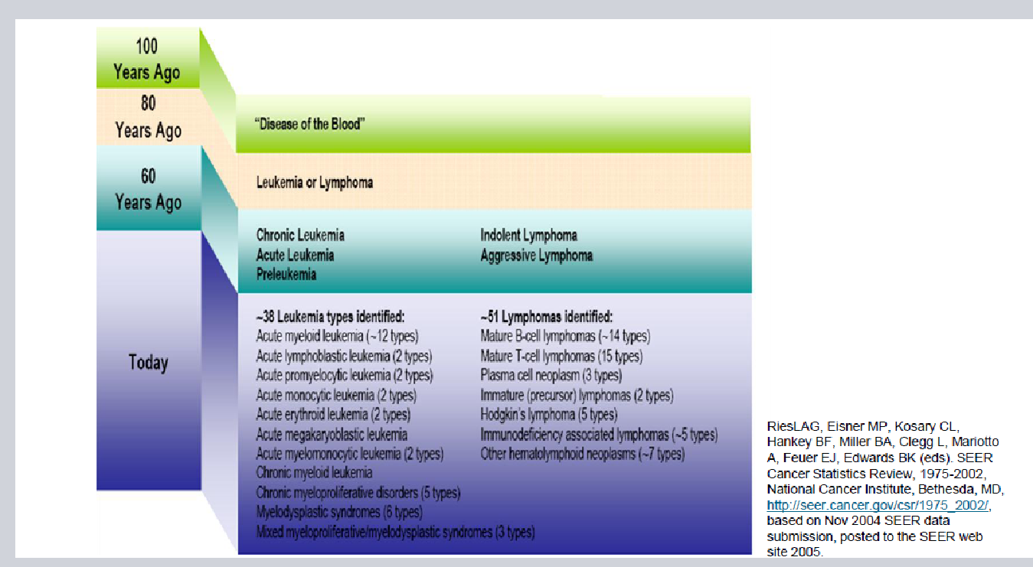
Our Understanding of the Complexities of Diseases is Accelerating
It is increasingly difficult to remember all these subtypes

Slide 16
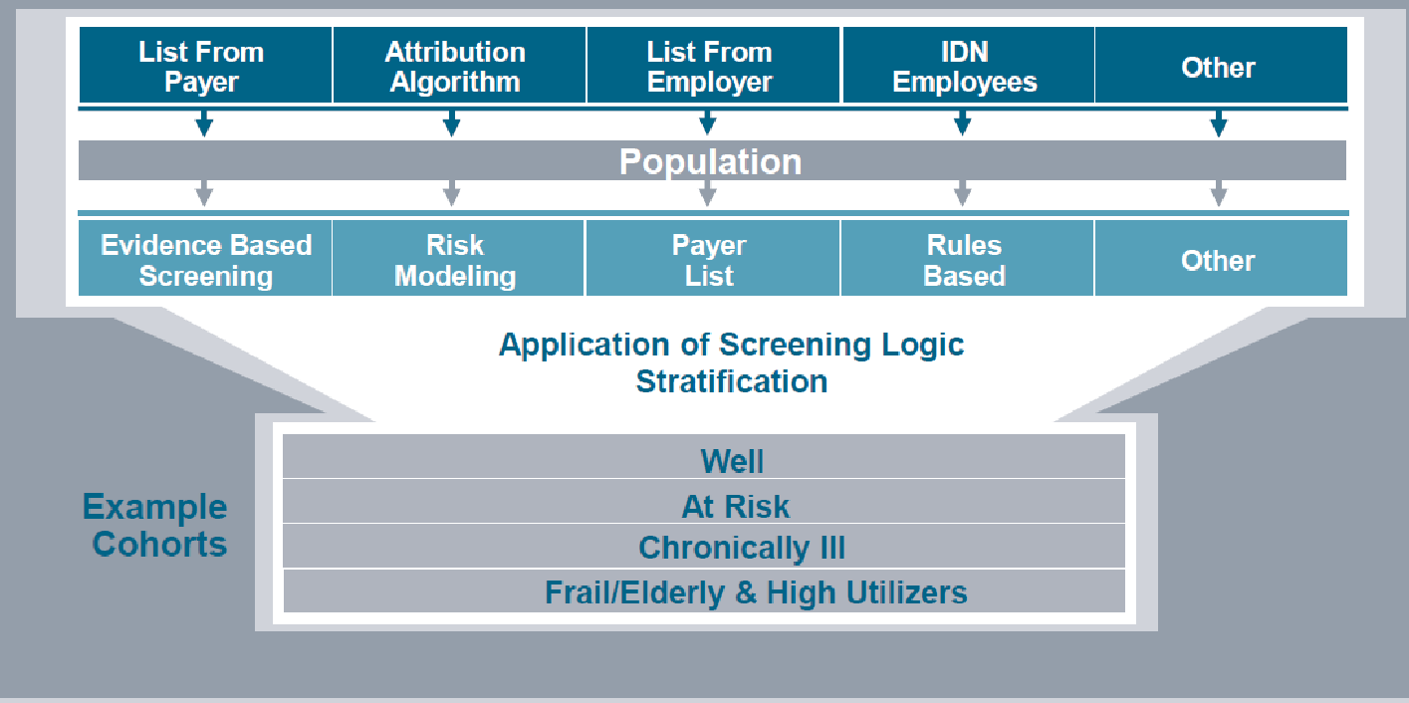
Analytics are needed to stratify the Patient Cohorts

Slide 17
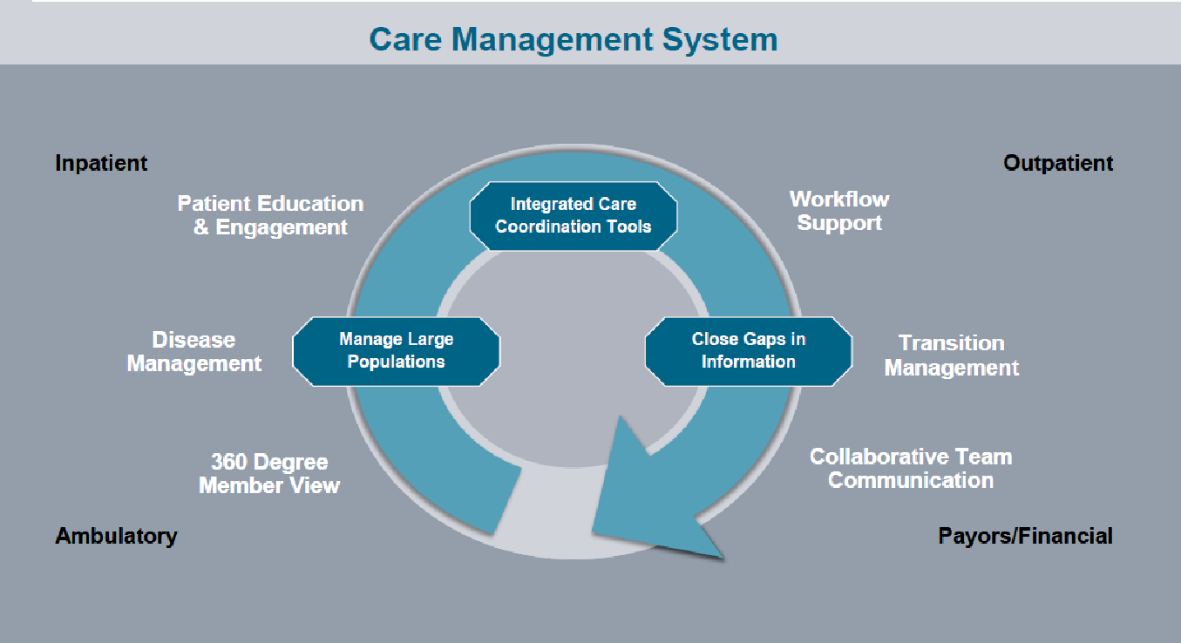
Analytics is needed for Disease Management

Slide 18
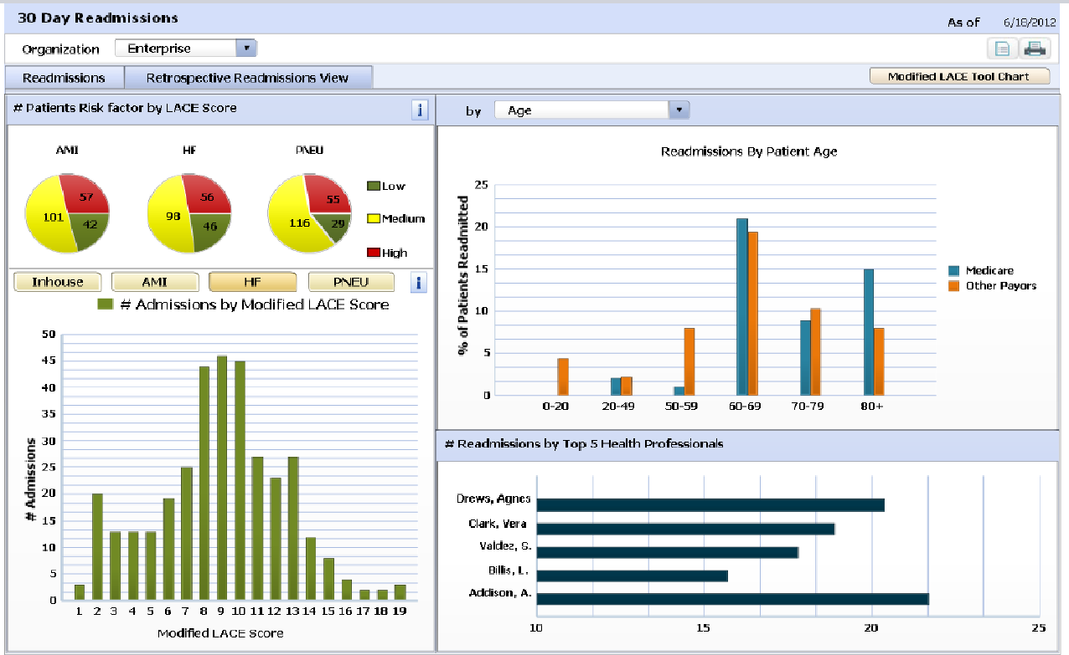
Analytics is needed for Readmission Management

Slide 19
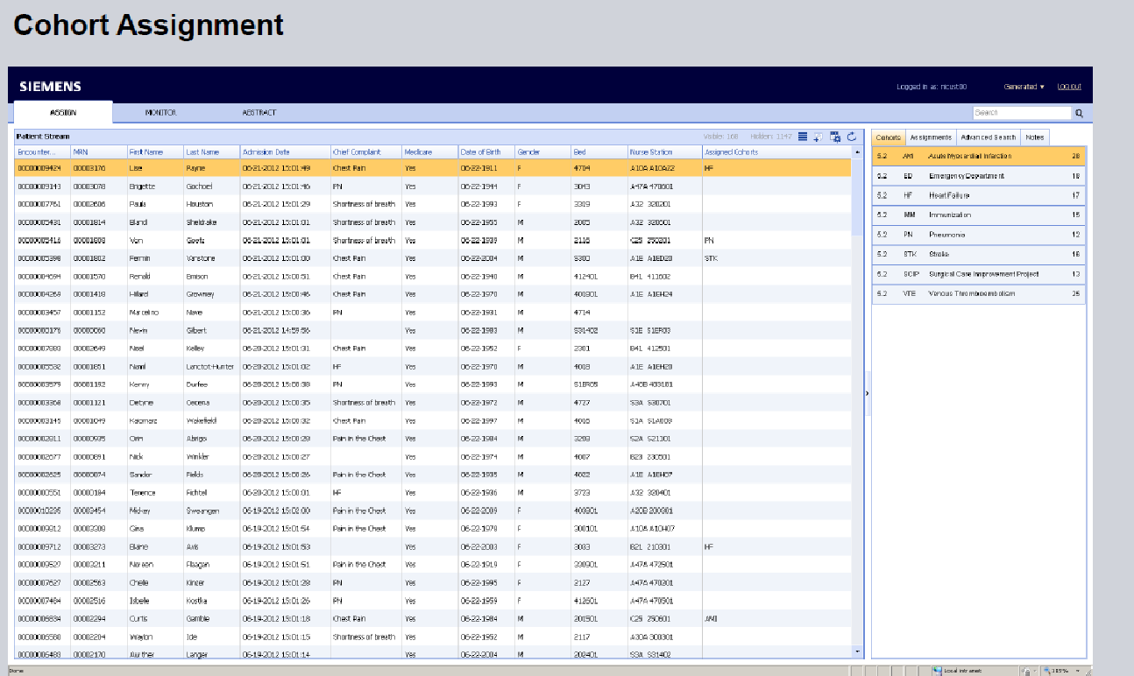
Analytics is needed for Measuring Performance

Slide 20
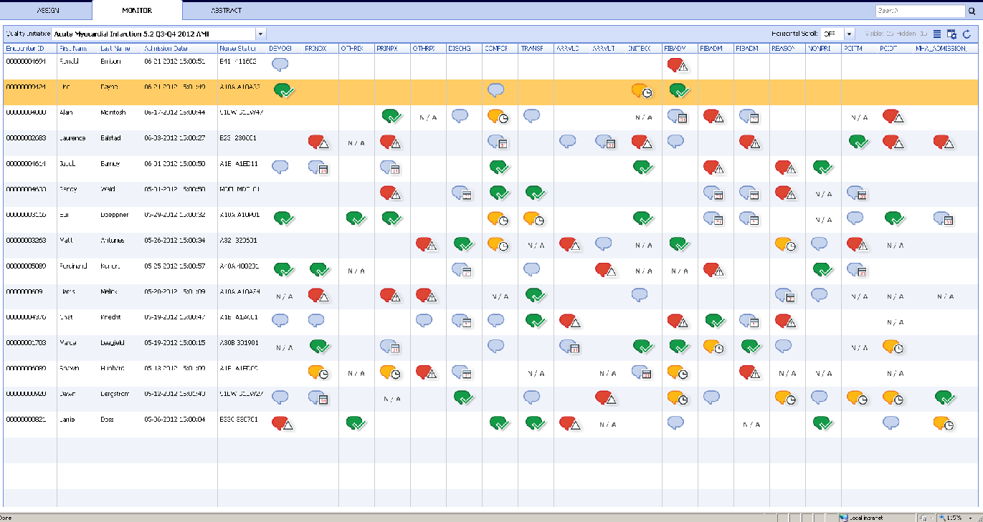
Analytics is needed for Patient Cohort Monitoring

Slide 21
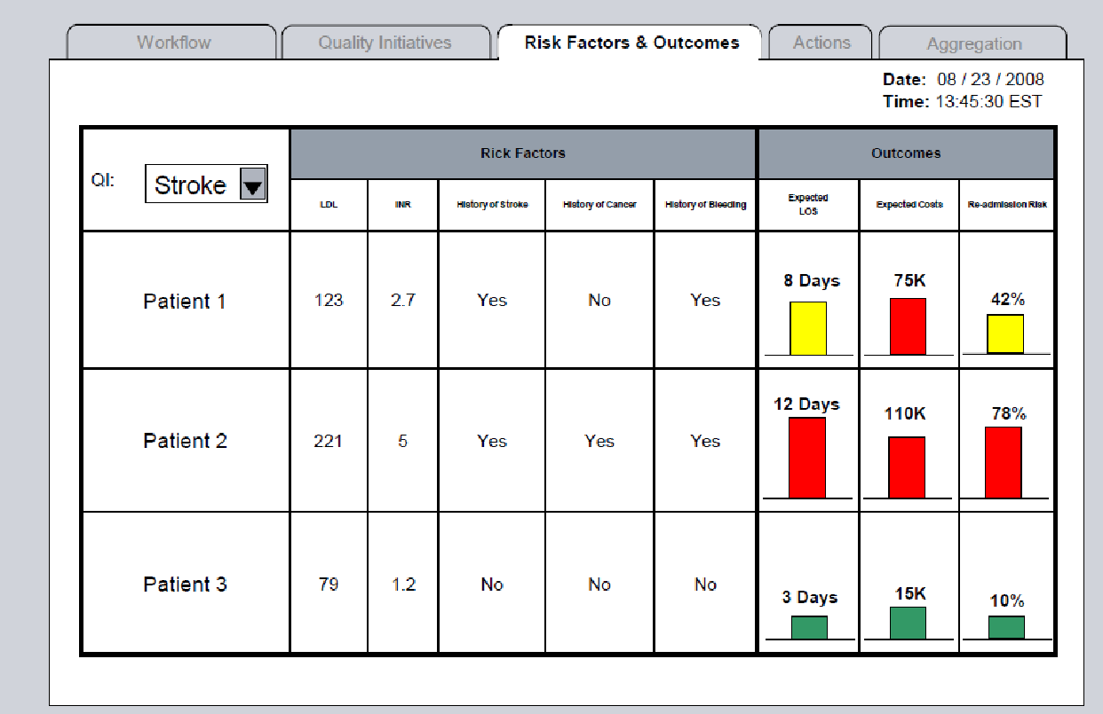
Analytics is needed for Predictive Output

Slide 22
Analytics is needed for …
Machine Reconciliation of Data Inconsistencies
Tailoring Cancer Therapy
Comparison of Relative Risk of Medications using EHR data
30-day Readmission
In-patient vs. ambulatory support
Emergency Department visit reduction
Personalized medicine
Genomics rule in Clinical Decision Support

Slide 23
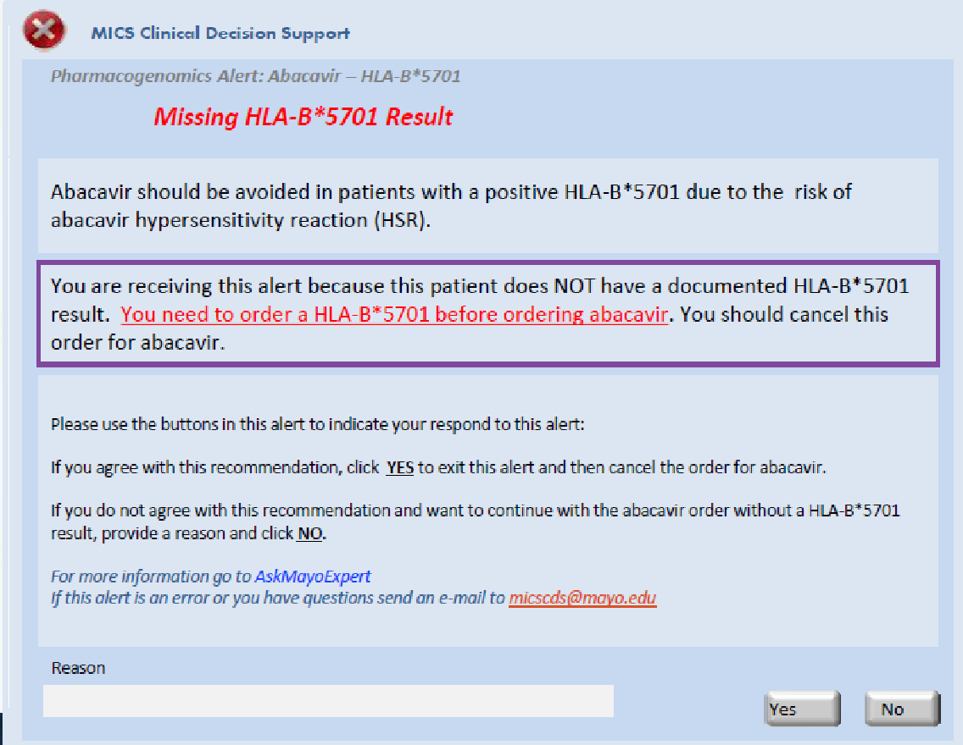
Pharmacogenomics

